Slide 1
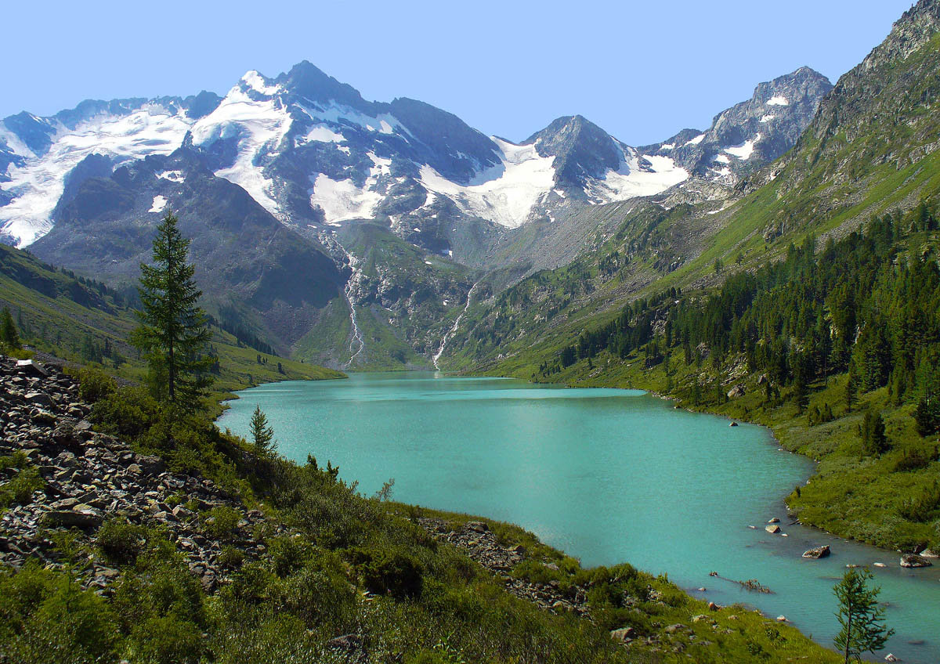
Russian reserves
Davlyatzanova A. R.
7v

Slide 2
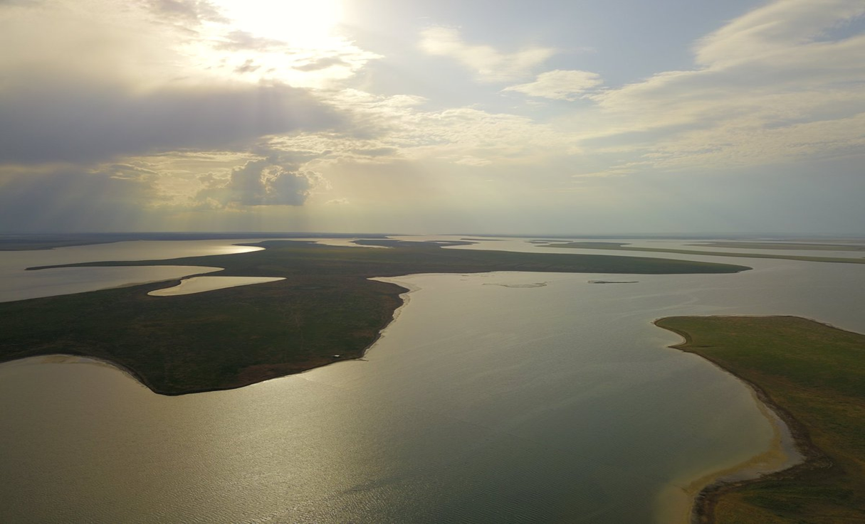
The Rostov State Reserve
The Rostov State Reserve was constructed in 1995 to save nature. This reserve is located in the Rostov Region. There are a lot of animals: hares, foxes, wolves, gophers etc. The Rostov reserve includes Manych-Gudilo lake.

Slide 3
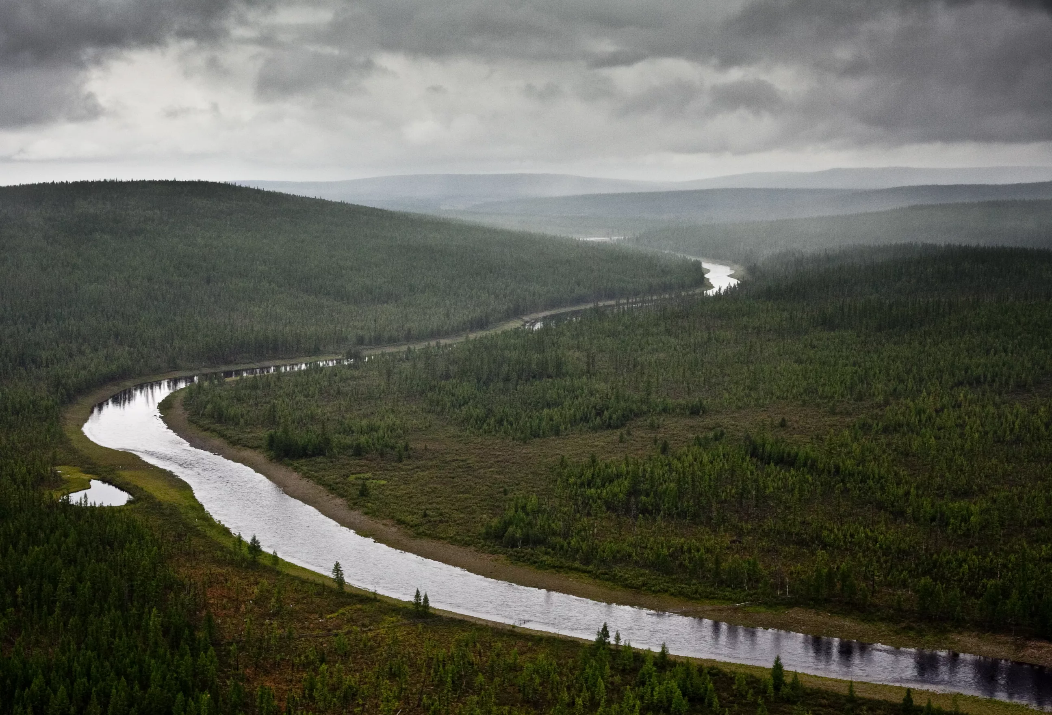
The Tunguska
Reserve
The Tunguska Reserve is located in the Krasnoyarsk Region.
Area of this reserve is incomparable.
It is different from other reserves because of interesting event: huge fireball, which flew over this reserve on the 30th of June 1908.
There are you can see different animals: reindeers and elks, wolves and bears.

Slide 4
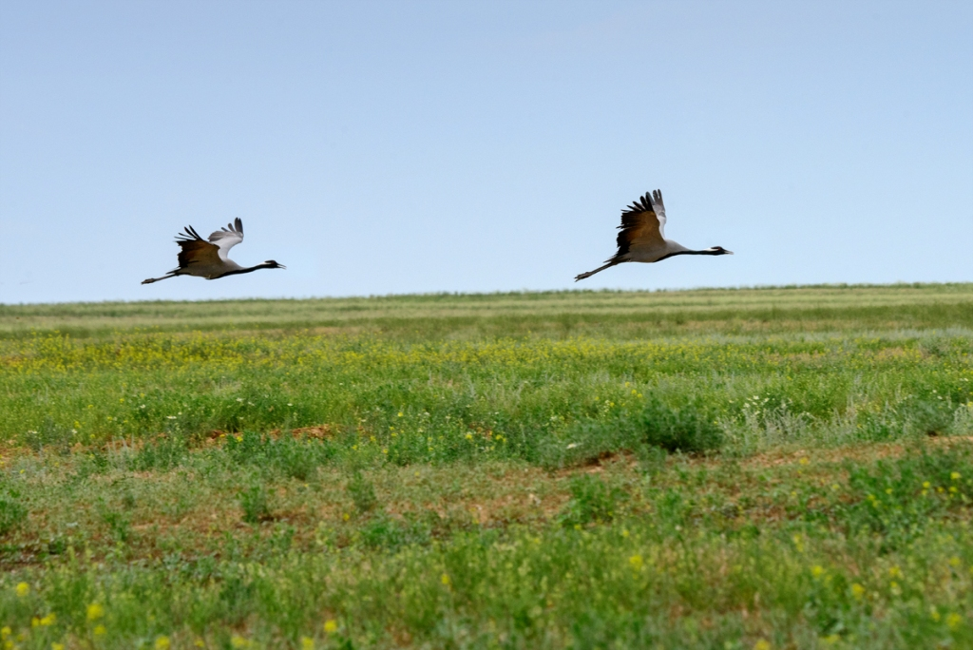
The Black lands biosphere reserve
The Black lands is located in the Respublic of Kalmykiya. This reserve was founded on the 11th of June 1990 because of anthropogenic desertification of the black lands

Slide 5
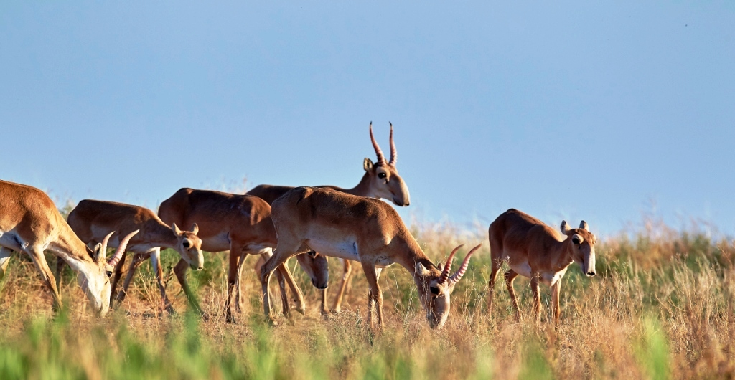
Saiga
Saiga is very interesting animal which has the following distinctive features. Color of wool depends on the time of year but usually it is reddish. Another feature is the hoof in the shape of a heart.

Slide 6
Thank you for attention

