Slide 1
Тема исследовательской работы:
History of two songs:“Happy birthday to you” and “We wish you a Merry Christmas”
Выполнила ученица
МБОУ Лицей № 96 5«Б» класса
Баглаева Диана
Научный руководитель
Тагирова Дарья Львовна
Уфа - 2013

Slide 2
Content
Introduction
Chapter 1. The History of two famous English songs
1.1. The History of the song:“Happy birthday to you”.
1.2. The History of the song:“We wish you a Merry Christmas”.
Chapter 2. “Happy birthday to you” and “We wish you a Merry Christmas” songs in Germany
Chapter 3. Do you know Happy birthday to you” and “We wish you a Merry Christmas” songs in German and in English?
Conclusion
Bibliography
Appendix

Slide 3
Introduction
When you go to the UK and switch on the TV you will see a lot of American and English shows, movies and films which, of course, are shown in the original, we can hear some historical songs in English, and even in German. It follows, English famous songs can be influenced on the future history of people and we can tell that it is a topicality of our research.

Slide 4
The purpose in our research is the historical meaning of variants of English songs, and to show similarities and differences of English and German songs. Some tasks are:
1. to tell some historical creation of these two songs”;
2. to show German variants of these two songs;
3. to tell about the songs in both countries;
4. to make a research in the 5th and 6th forms.
Practical value is that the results of research can be used at school lessons, in out-of-class events.

Slide 5
Chapter 1. the History of two famous English songs
All the songs of Christmas have a universal appeal. The song ‘We Wish you a merry Christmas' brings a smile on the face of anybody who listens to it. We wish you a Merry Christmas History reverts back to the 16th century.

Slide 6
It is the world’s most well-known and popular song. It has been sung hundreds of millions of times each year for over three-quarters of a century. And it is the only song in the English language guaranteed to make people of all ages smile and sing along. The song, of course, is “Happy Birthday to You.”

Slide 7
1.1. The History of the song:“Happy birthday to you” .
It was originally called "Good Morning to All". The song "Happy Birthday To You" has become a classic, sung at birthday parties around the world.
The melody and lyrics of "Happy Birthday to You" were written by sisters Mildred J. Hill and Patty Smith Hill.
The song became popular and in 1934, the "Good Morning to You" melody in "Happy Birthday to You" was unauthorized.

Slide 8
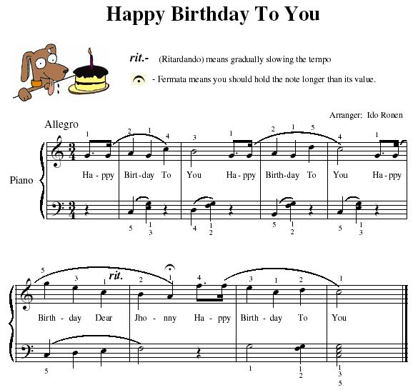

Slide 11
1.2 The History of the song:“We wish you a Merry Christmas”.
The songs composer and author remains unknown, however, it is believed to be a sixteenth century West Country English carol. The song itself was meant for carolers who were hired to entertain the wealthy, in turn, the carolers would receive treats.
The earlier history of the carol is unclear.

Slide 13
Chapter 2: “Happy birthday to you” and “We wish you a Merry Christmas” songs in Germany
the "Happy Birthday" song we are familiar with in English and a special, much longer, and very touching song that celebrates the person's life.
Zum Geburtstag viel Glück,
Happy Birthday to You,
Zum Geburtstag liebe (name)
Happy Birthday dear (name)
"Alles gute zum geburtstag" means "happy birthday" and is a traditional way to wish someone a happy birthday in German.(8) "Wir wunschen dir frohe Weinnacht" means "We wish you a merry Christmas " and is a traditional way to wish someone a Merry Christmas in German.

Slide 15
Chapter 3. Do you know Happy birthday to you” and “We wish you a Merry Christmas” songs in German and in English?
When we began writing this work, we decided to make a quiz among students of the 5th-6th forms. There was a test about the history of “Happy birthday to you” and “We wish you a Merry Christmas” songs. And the second was an interrogation of students knowledge of songs’ lyrics.

Slide 16
Test
1.Who had written Happy Birthday to you song?
A)sisters Mildred J. Hill and Patty Smith Hill
b)unknown
c)it is a folk song
2.What was the first version of Happy Birthday to you song?
a)Good morning to you
b)Good afternoon to you
c)Good evening to you
3.What was the author of We wish you a merry Christmas?
a)Unknown
b)Davies Gilbert
c)William Sandys
4.What is a traditional English Christmas dessert?
a)Apple pudding
b)Figgy pudding
c) Orange pudding
5.When were a Christmas carols banned all throughout England?
a)In 1880
b)between 1647-1660
c)between 1598-1601

Slide 17
After this test we realized that students knew the history not bad, although the students got confused when answer the 5th question.
And after all, we ask just one question: Do you know these songs’ lyrics in German and in English?
Unfortunately we realize, that not all the students know songs’ lyrics in German.
You can see the results of the test in our presentation

Slide 21
Conclusion
The journey of “Happy Birthday to You” and “We wish you a merry Christmas” are unique in the history of popular song.
In our research we can say, that we:
1. told historical creation of these two songs;
2. shown German variants of these two songs;
3. told about the songs in both countries;
4. made a research in the 5th and 6th forms.
We should say that all tasks, purpose, research in our work were determined. The research shown us positive results and good knowledge of students.

Slide 22
Thank you for your attention!!!

